Slide 1
FY26 Budget Feedback Meeting

Slide 2
AGENDA
Action Items (add items as needed)
  Approval of Agenda
  Approval of Previous Minutes
Discussion Items (add items as needed)
  Budget Development Presentation
    ACTION ITEM: GO Team vote on Draft Budget (AFTER presentation and discussion)
  Discussion Item 2: [add description of the item]
Information Items (add items as needed)
  Principal’s Report
  Committee Reports (as needed)
  Cluster Advisory Report (if CAT has met since last meeting)
Announcements (add items as needed)
Public Comment (if applicable)

Slide 3
Meeting Norms
This is a meeting of the GO Team. Only members of the team may participate in the discussion. Any members of the public present are here to quietly observe.
We will follow the agenda as noticed to the public and stay on task.
We invite and welcome contributions of every member and listen to each other.
We will respect all ideas and assume good intentions.

Slide 4
Budget Feedback presentation & Discussion

Slide 5

GO Team Budget Development Process
YOUR SCHOOL STRATEGIC PLAN…
is your roadmap and your role.
It is your direction, your priorities, your vision, your present, your future.
Step 1: Data Review
Step 2: Strategic Plan Review
Step 3: Budget Parameters
(Strategic Priorities)
Step 4: Budget Choices

Slide 6
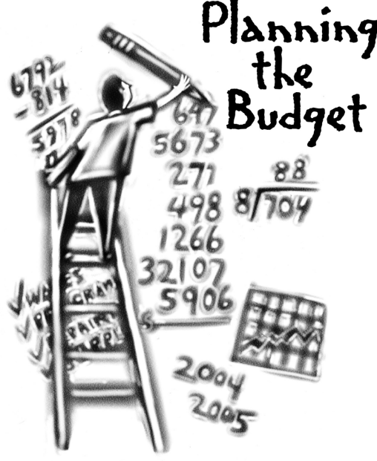
Overview of FY26 GO Team Budget Process
Step 2 Principals Workshop FY 26 Budget
January 15
Step 4 Principals Cluster Supt. Discussions
Step 1 Update Strategic Plan & Rank Priorities
Step 7 Principals HR Staffing Conferences Begin
Feb. 24-27
Step 3 GO Team Initial Budget Session
January 15-31
Step 8* GO Team Final Budget Approval Meeting
Budgets Approved by March 14
Step 6 Cluster Supt. Review February 17-21
Step 5* GO Team Feedback Mtg. February 10-14
GO Teams are encouraged to have ongoing conversations
* GO Teams will need to take ACTION on the budget at these meetings.

Slide 7
Budget Feedback Meeting
What
During the GO Team Feedback meeting the principal will share the 25-26 Strategic Plan Breakout, provide an overview of the school’s draft budget, share updated tabs from the Excel template, and review/collaborate with the GO Team on the comments/notes to explain the use of school-level flexibility in budget allocations.
Why
This meeting provides an opportunity for GO Teams to discuss the principal’s proposed budget and how it supports the school's programmatic needs and key strategic priorities for the 25-26 school year. It also provides the GO Team the opportunity to review and provide feedback on proposed use of school-level flexibility.
When
Early February 10 - February 14th, before Cluster Superintendent review.

Slide 8
Mission Paul L. Dunbar is a school where excellence is expected, and all students are developed academically, socially, and emotionally in order to become globally competitive.
School Name: Dunbar Elementary School
Vision: Paul L. Dunbar Elementary is a school that nurtures and develops life-long learners who are problem solvers and internationally minded citizens.
SMART Goals
By May 2025, we will increase the % of students in grades 3-5 scoring proficient or above in reading by 5% from 22% to 27% and decrease students scoring beginning by 5% from 53% to 48% on MAP.
By May 2025, we will increase the % students in grades 3-5, scoring proficient or above in math by 5% from 10% to 15% and decrease students scoring beginning by 5% from 58% to 53%.
By May 2025, we will increase the % of CCRPI Attendance from 60% to 65%. (5% Growth)
APS Strategic Priorities & Initiatives
School Strategic Priorities
School Strategies
1.Offer an academically challenging curriculum that prepares students for college and career readiness
2. Ensure a safe effective learning environment that encourages the use of an instructional framework to explicitly teach reading and math
3.Ensure that all students learn about multiple topics from a variety of different viewpoints.
1A. Align the school schedule to create collaborative planning session for each teacher
1B. Aligned the instructional framework to maximize instructional time in the classroom.
1c.Integrate reading strategies and fluency facts into all exploratory courses
2a. Ensure all classroom are print –rich with Literacy Centers that focus on various reading skills
2b.. Ensure all classroom are using visual supports and engaging texts to increase literacy
3a 1Emphasize problem-solving strategies and encourage students to explain their reasoning
3b. Ensure Math Centers allows students to practice a variety of difference skills at their own pace
Fostering Academic Excellence for All Data
Curriculum & Instruction Signature Program
Building a Culture of Student Support
Whole Child & Intervention Personalized Learning
4a.. Complete ongoing data protocol with teachers during collaborative planning
4B. Use if frequent common assessments , analyze date, use to guide instruction
6a .Integrate SWD professional learning to structure special education instructional framework
4c/5b. Implement a school wide behavior plan (PBIS focused) / Implement attendance Incentives
4. Effectively use existing and appropriate tools to measure, analyze, and communicate student progress
5. Effectively monitor attendance protocols and systems
6. Create a collaborative, inclusive, and responsive school culture
Equipping & Empowering Leaders & Staff
Strategic Staff Support Equitable Resource Allocation
6a.. Implement and Monitor professional learning collaborative planning to review instructional framework
6b. Continue to build instructional teams to support the teachers and students
7a .Integrate SEL Awareness and moment to build positive work environment
7. Build teacher capacity to meet the academic needs of the students
8. Create a Supportive Work Environment that motivates and retains staff.
8a.. Implement Wellness Days and celebrate teachers and staff for attendance, data, personal accomplishments
9a. Increase math manipulatives, literacy manipulatives, and reading centers
10a Encourage Endorsements in Reading, math, technology to increase professional knowledge.
11a. Build and sustain parent engagement, community partnerships, and student voice
Creating a System of School Support
Strategic Staff Support
Equitable Resource Allocation
9. Provide necessary resources to enhance teaching and learning in all spaces
10. Attract and build capacity of talented and knowledgeable staff to meet school needs
11. Build and sustain parent engagement, community partnerships, and student voice
TBD: tbd
14

Slide 9
Dunbar ES Strategic Plan
Priority Ranking
Higher
Attract and build capacity of talented and knowledgeable staff to meet school needs.
Ensure a safe and effective learning environment that encourages the use of an instructional framework utilized across all content areas for more personalized learning.
Offer an academically challenging curriculum that prepares students for college, career, and citizenship.
Ensure that all students learn about multiple topics from a variety of different viewpoints.
Build teacher capacity with the ability to meet the diverse social and academic needs of students.
Effectively monitor attendance protocols and systems.
Create a collaborative, inclusive, and responsive school culture embracing the diverse communities that comprise the Dunbar ES family.
Create an environment that motivates and retains staff members.
Effectively use existing and appropriate tools to measure, analyze, and communicate student progress.
Provide necessary and salient resources to enhance teaching and learning in all spaces.
Build and sustain parent engagement, community partnerships, and student voice.
Lower

Slide 10
FY 26 Budget Parameters
FY26 Ranked School Priorities | Rationale
1) Attract and build capacity of talented and knowledgeable staff to meet school needs. | Recruiting and retaining highly skilled educators is key to a school’s success. Building staff capacity through ongoing professional development ensures that the school can adapt to evolving educational challenges and provide students with a top-notch learning experience.
Ensure a safe and effective learning environment that encourages the use of an instructional framework to explicitly teach reading and math. | A safe and structured environment fosters student engagement and academic success. An instructional framework ensures consistency and effectiveness in teaching core subjects like reading and math, which are foundational to all areas of learning.
Offer an academically challenging curriculum that prepares students for college and career readiness. | A challenging curriculum equips students with the skills and knowledge they need to succeed in higher education and future careers.

Slide 11
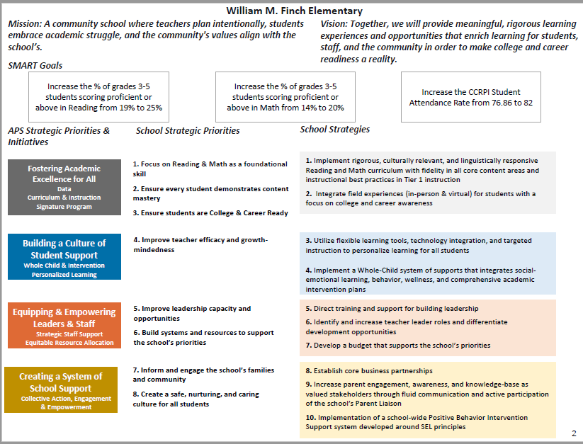
(School Name) Strategic Plan
Insert Your School's FINAL, APPROVED Strategic Plan

Slide 12
(School Name) Strategic Plan
Priority Ranking
Insert the school’s ranked priorities from High to Low
Higher
Insert Your School's FINAL, APPROVED Ranked Priorities
Lower

Slide 13
FY 26 Budget Parameters
FY26 Ranked School Priorities | Rationale
Maintain lower class sizes in the primary years by funding parapros in 1st and second grade | 47% mobility rate requires a great deal of teacher attention to students who enter our school throughout the year – many of which are below level.
Maximize wrap around services ie: Nurse, SSW, Counseling | This continues to be a need for our students, but we need to look closely at maximizing our budget to make this work.
Increase Reading/Lexiles and writing of 3rd – 5th grade students. How can we restructure our program to achieve this? | Data indicates that students who have been with us for more than one year have greater performance levels than students who are transient. With 47% of our students coming and going, there is a need to target these students.
Example: Before Presenting to your GO Team:
Update with Your Team's
Priorities and Rationale
Use as many slides as necessary

Slide 14
FY 26 Budget Parameters
FY26 Ranked School Priorities | Rationale
Maintain lower class sizes in the primary years by funding parapros in 1st and second grade | 47% mobility rate requires a great deal of teacher attention to students who enter our school throughout the year – many of which are below level.
Maximize wrap around services ie: Nurse, SSW, Counseling | This continues to be a need for our students, but we need to look closely at maximizing our budget to make this work.
Increase Reading/Lexiles and writing of 3rd – 5th grade students. How can we restructure our program to achieve this? | Data indicates that students who have been with us for more than one year have greater performance levels than students who are transient. With 47% of our students coming and going, there is a need to target these students.
Example: Before Presenting to your GO Team:
Update with Your Team's
Priorities and Rationale
Use as many slides as necessary

Slide 15
Review of FY26 Signature and Turnaround Program Funding Process
Overview
* The district is piloting a zero-based budgeting (ZBB) process for Signature and Turnaround Program Funds this year.
* Zero-based budgeting (ZBB) is a budgeting process that allocates funding based on program efficiency and necessity rather than budget history. As opposed to traditional budgeting, no item is automatically included in the next budget.
* As such the initial allocation for these programs at all schools will be $0.
Process
* Principals will develop proposed requests for the personnel and non-personnel they need to support the Signature and/or Turnaround Programs at their schools.
* Principals will share and discuss their proposals and rationale for the proposals with their school GO Team for feedback.
* After discussing with their GO Team, principals will submit their request for review by January 31st. Funding for these programs will be provided the week of February 3rd.

Slide 16
Overview of Approved Signature Program Funds

Slide 17
Signature program funds requested vs. approved
Requested Signature Program Funds: $224,132
PRINCIPALS: Please update with the list of what you requested to support your signature program. Example: Signature Program Coach Signature Program World Language Teacher Signature Programming Supplies/Resources
APPROVED Signature Program Funds: $204,132
PRINCIPALS: Please update with the Staffing and Non-Staffing allocation of your updated Signature Program funds. Signature Program Coach Signature Programming Supplies/Resources

Slide 18
Overview of Approved turnaround Funds

Slide 19
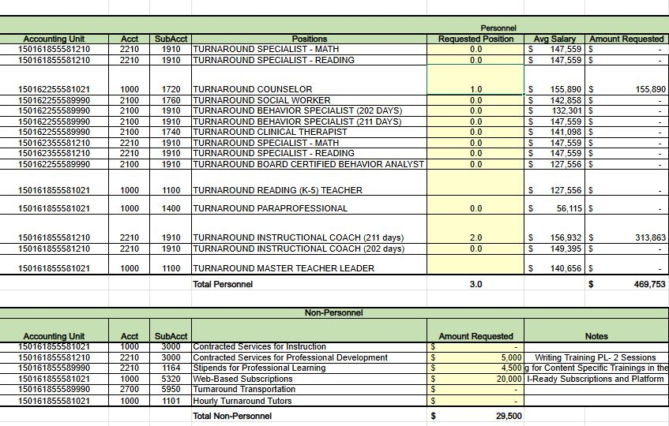
Approved FY26
Turnaround Funds

Slide 20
ImPACT TO INSTRUCTION
Request | Rationale | Impact to Instruction
1 Reading Specialist 1 Math Specialist 1 Paraprofessional Total Cost $ 351, 233 | Reading and Math Specialists and the curricular resources necessary to work directly with students in small groups to build foundational skills in reading and/or math based on data. | All three positions have currently been added to the general budget to continue supporting the students. Total Cost: $ 311, 227 Difference $40,006

Slide 21
Dunbar Elementary School
FY26 Summary of Proposed Staffing AND Non-Staffing
-

Slide 22
Summary Tab Overview
The Summary Tab provides a summary of the staff in our school. The columns show how many positions are:
Earned – positions allocated by district departments. There is no school-level flexibility with these positions.
Funded – District’s recommended staffing for positions where there is school-level flexibility with staffing the position.
Staffed – This shows how the principal plans to staff the position for the FY26 school year.
Difference—This shows the difference between the recommendation from the District and the Principal's proposed FY26 staffing plan.
Comments: The principal must provide comments if there is a difference in what is Funded and Staffed. Principals and GO Teams will discuss the rationale provided for the Comments section.

Slide 23
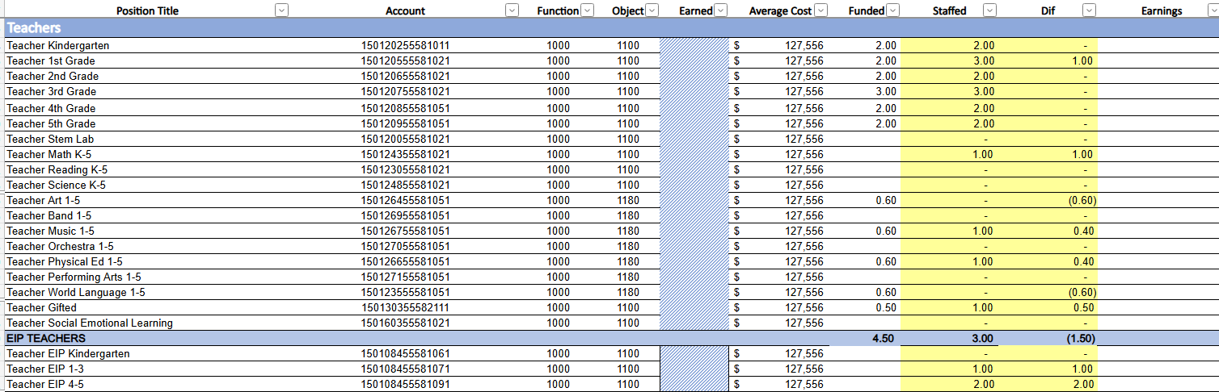

Slide 24
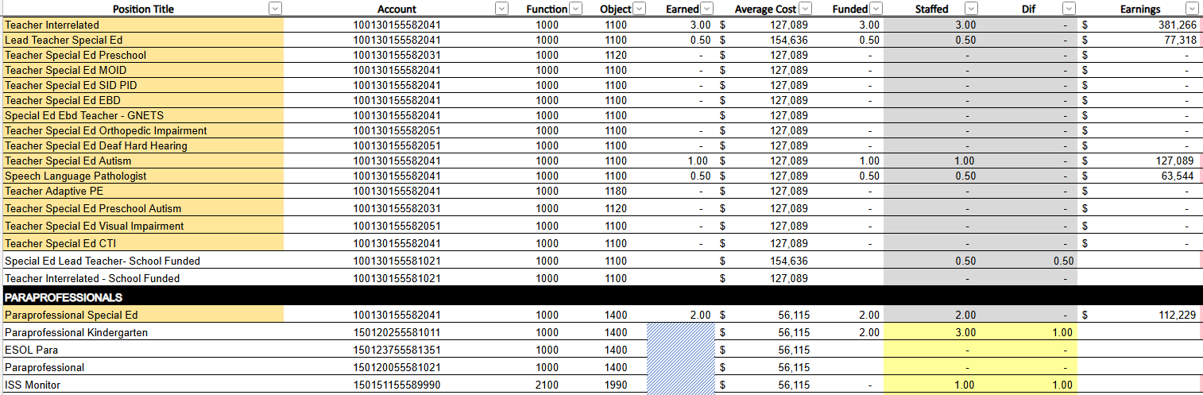

Slide 25
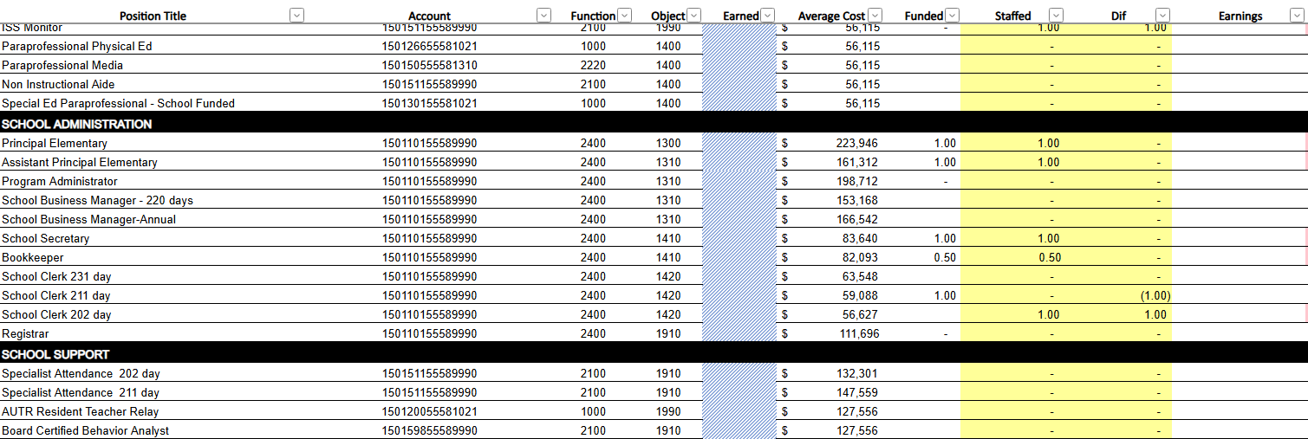

Slide 26
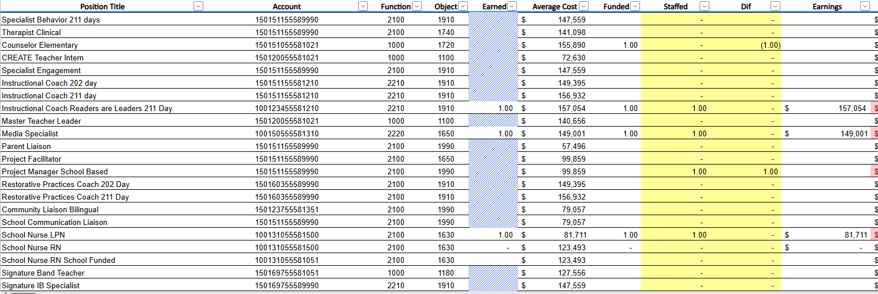

Slide 27
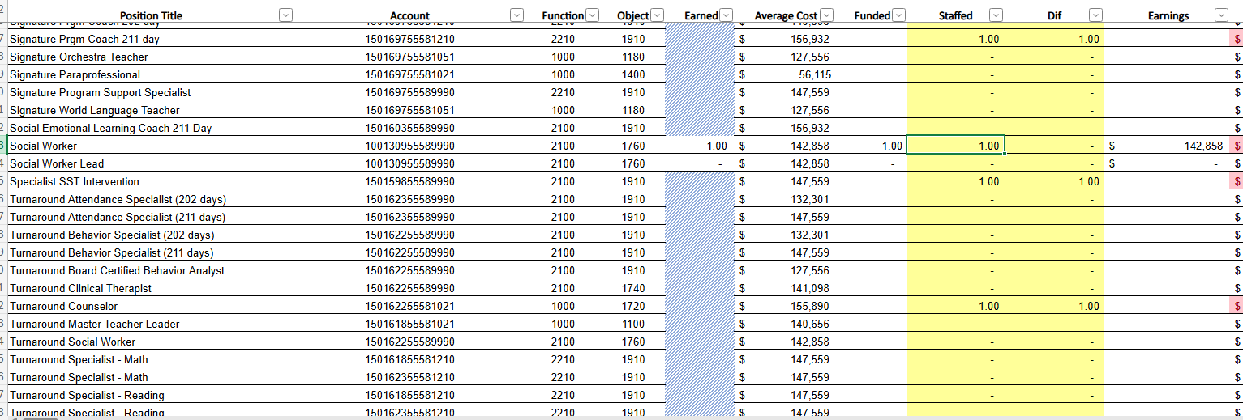

Slide 28
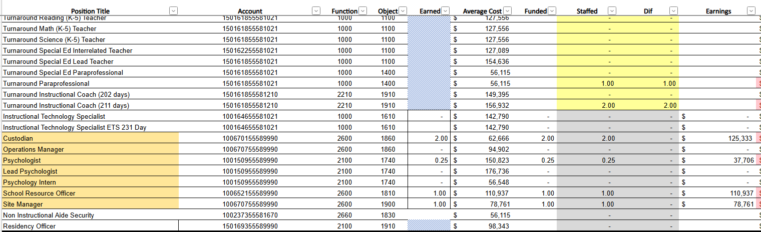

Slide 29
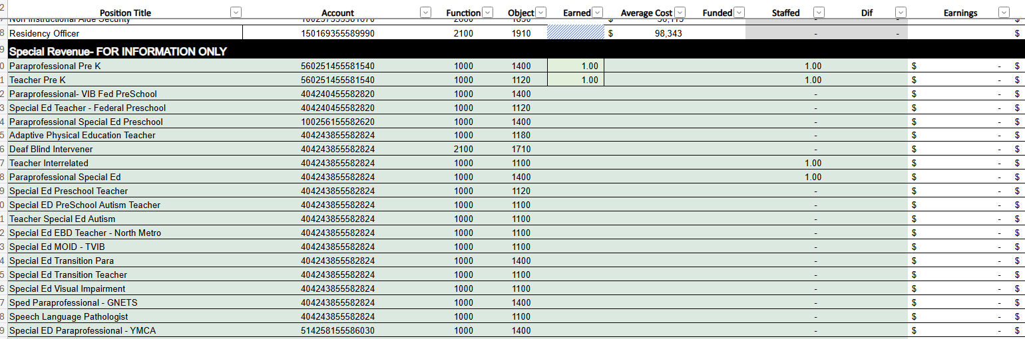

Slide 30
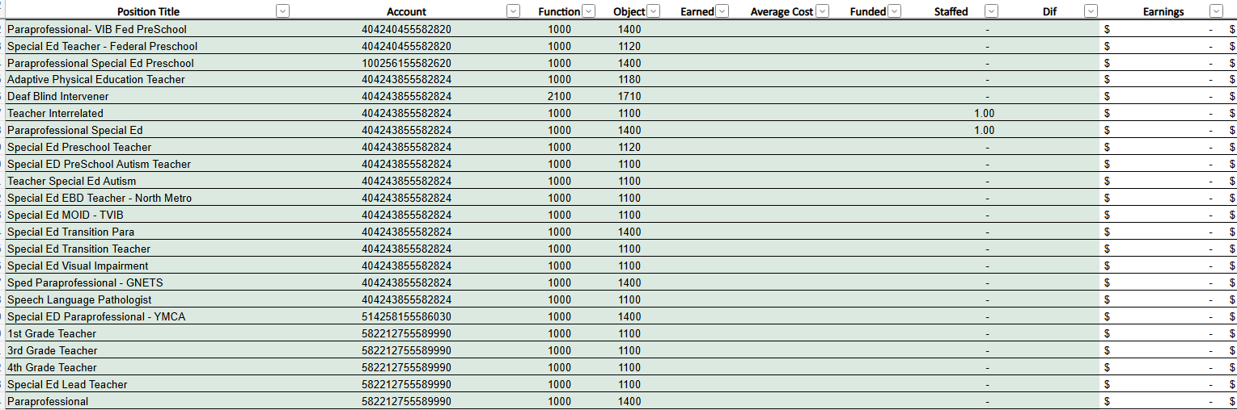

Slide 31
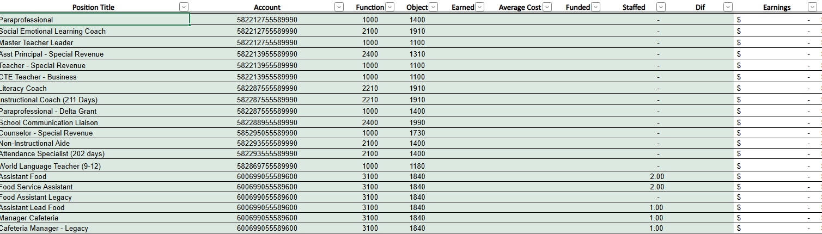

Slide 32
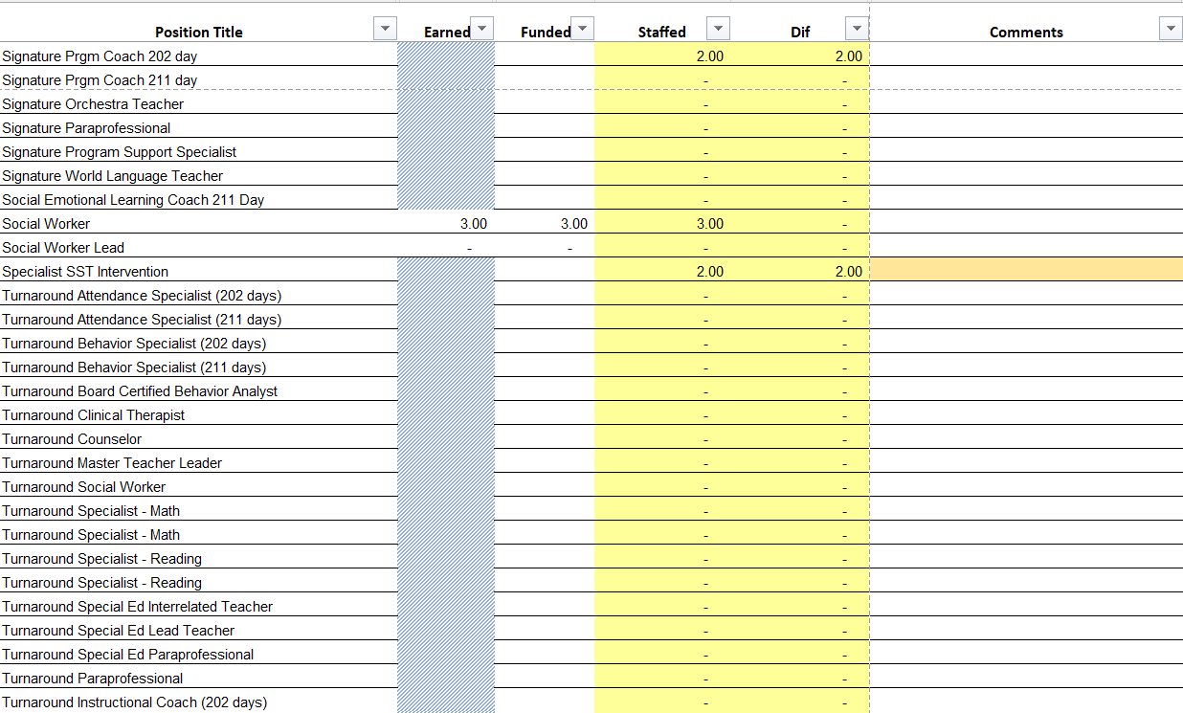
Example: Update with your school's Summary Tab- Use as many slides as needed. Please make sure the information on these slides reflects what you plan to send to your Cluster Supt. And your Staffing Conference

Slide 33
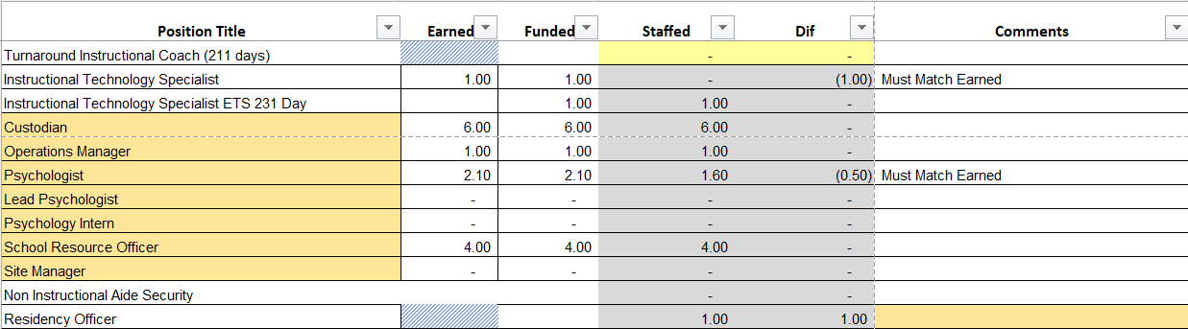
Example: Update with your school's Summary Tab- Use as many slides as needed. Please make sure the information on these slides reflects what you plan to send to your Cluster Supt. And your Staffing Conference

Slide 34
Summary of position Changes to Support the fy26 bUDGET
CREATED | REMOVED
K-5 EIP Reading Teacher | 1 Art Teacher
K-5 EIP Math Teacher | 1 World Language Teacher
1 Project Manager School Based | 1 Parent Liaison
.5 Special Ed Lead Teacher( District provides .5)
1 Instructional Paraprofessional (Small Group Instruction)
Hourly Art Teacher Hourly World Language Teacher
Summary of Changes
Reading and Math Teacher will continue to provide students with reading and math instruction. Special Education Numbers have increased from 9 students to 40 students within the current academic school year. Dunbar also has a Functional Regional Unit.

Slide 35
Non-Staffing Tab Overview
The Non-Staffing Tab shows how funds are allocated for non-staff items in the school. There is school-level flexibility for most of these items. The tab has columns for:
Recommended—District’s recommended amount to spend on the line item.
Allocation – This shows how much the principal is proposing to allocate towards the line item in FY26.
Difference—This shows the difference between the recommended amount and the allocation.
Notes: The principal must provide comments if there is a difference in what is Recommended and what is Allocated. Principals and GO Teams will discuss the rationale for the notes section.
Description | Rec. | Allocation | Diff | Notes
Reserve | $ 291,149 | $ 291,149 | $ -
Teacher Stipends |  |  | $ -
Secretary Overtime |  |  | $ -
Contracted Services for Instruction |  |  | $ -
Contracted Services for Professional Development |  |  | $ -
Web-based Subscriptions and Licenses |  |  | $ -
Signature Program Communication/Shipping Fee |  |  | $ -
Computer Software |  | $ - | $ -
Mileage |  |  | $ -
Student Transportation-APS Buses |  |  | $ -
District Funded Field Trips | $ 60,886 | $ 60,886 | $ -
Teaching/Other Supplies | $ 81,900 |  | $ (81,900)
Signature Program Supplies |  |  | $ -
Computer Equipment |  |  | $ -
Media Supplies | $ 13,104 |  | $ (13,104)
Example

Slide 36
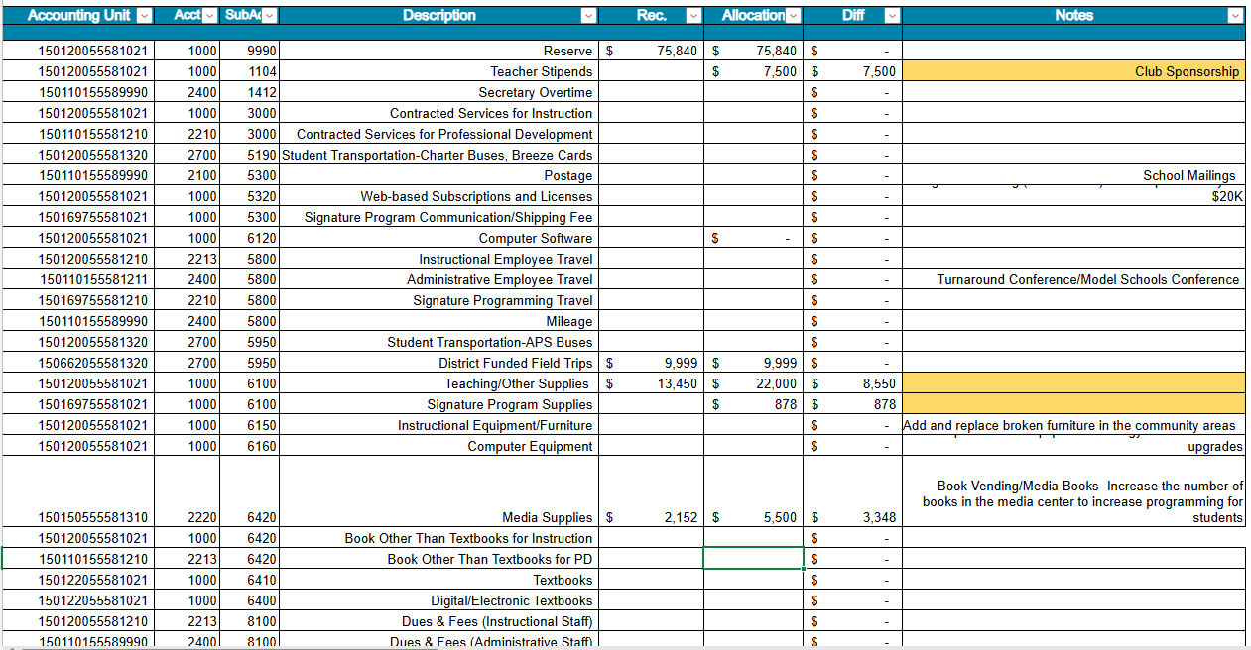

Slide 37
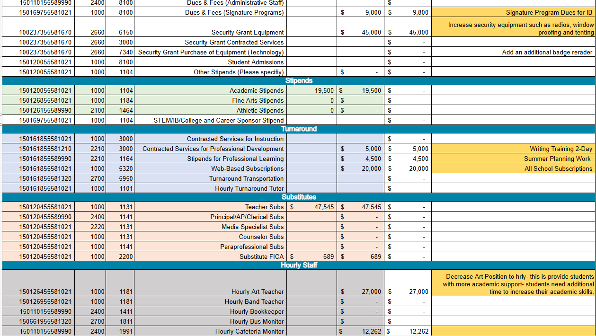

Slide 38
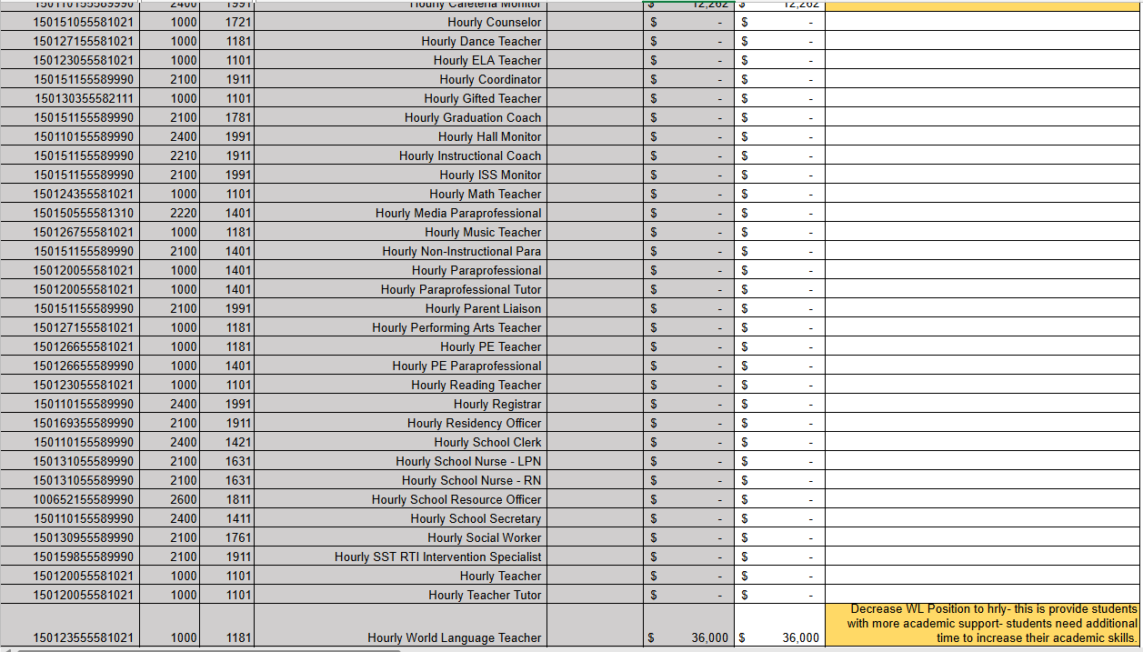

Slide 39
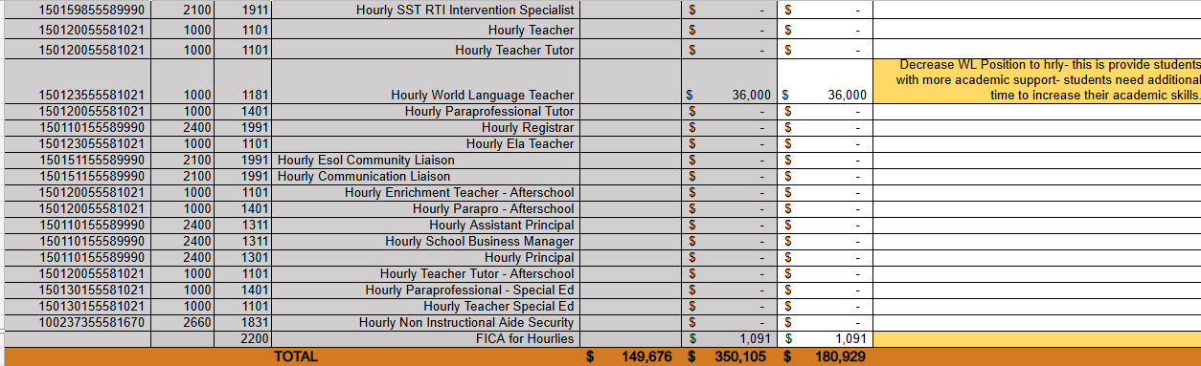

Slide 40
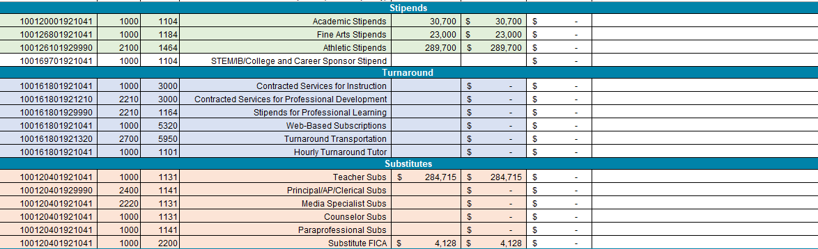
Non-Staffing Tab Continued
Example: Update with your school's Non-Staffing Tab
Please make sure the information on these slides reflects what you plan to send to your Cluster Supt. And your Staffing Conference

Slide 41
Descriptions of Strategic Plan
Breakout Categories
Priorities: FY25 funding priorities from the school’s strategic plan, ranked by the order of importance.
Strategies: Lays out specific objectives for school’s improvement.
Request: “The Ask” What needs to be funded in order to support the strategy?
Amount: What is the cost associated with the Request?

Slide 42
FY26 Strategic Plan Break-out
Priorities | Strategies | Requests | Amount
Attract and build capacity of talented and knowledgeable staff to meet school needs. | Attend all job fairs and post any available jobs in a timely manner to attract teachers early. | Branding Supplies for the school- Currently the school is not labeled at the entrance. Banners, Flyers, etc. | $3000 ( Teaching Supplies)
Ensure a safe and effective learning environment that encourages the use of an instructional framework utilized across all content areas for more personalized learning. | Ensure to purchase any necessary supplies or consumables to support the New ELA Standards and curriculum resources | Teaching Supplies, Teacher Stipends, Subscriptions, | $22,000 $19,500 $20000
Build teacher capacity with the ability to meet the diverse social and academic needs of students. . | Differentiated Professional Development, Peer Collaboration & Data- Driven Decision Making, Mentoring and Coaching | PL Opportunities and GLC | $19,500 Stipends $7500 Club Sponsorships $5000 PL Opportunities Sub Budget Undetermined $47, 545
Effectively monitor attendance protocols and systems. | Continue to provide rewards and incentives for students to continue to increase our overall CCRPI Attendance- Currently 74.1 | Project Manager School Based Position- This position will handle partnerships, donations, and overall special revenue budget
Create a collaborative, inclusive, and responsive school culture embracing the diverse communities that comprise the Dunbar ES family. | Equitable Access to Learning: ensure that students with diverse learning needs receive high-quality, individualized instruction aligned with inclusive practices. Collaboration Across Stakeholders: Create a bridge between general education and special education, promoting co-teaching models and professional development on inclusive strategies .Compliance & Best Practices: compliance with federal and state laws while promoting best practices in differentiated instruction, fostering a more inclusive school culture. | Full Time Special Education Lead Teacher Project Manager School Bases Position | $77318
Create an environment that motivates and retains staff members. | Dunbar is fully staffed with the amount of needed teachers per grade levels to maintain class sizes of less than 20 with the various needs | Maintain the total number of teachers (3 Teachers per grade level in 3-5) | $2,048,000
Effectively use existing and appropriate tools to measure, analyze, and communicate student progress. | Ensure teachers have the web subscriptions and resources necessary to communicate progress | Web Subscriptions, paper and ink | $22000
Provide necessary and salient resources to enhance teaching and learning in all spaces. | Ensure Staff have all of the necessary subscriptions and resources at the start of the school year | Teaching Supplies, Resources, Stipends, | $20000 (Subscription) $22000 (Teaching Supplies0
Build and sustain parent engagement, community partnerships, and student voice | Increase Parent Engagement and community partnerships, and student voice by increasing programming; reaching out to community partnerships | Project Manager School based position | $ 99859

Slide 43
FY26 Strategic Plan Break-out
Priorities | Strategies | Requests | Amount
Increase level of rigor and relevance (example- please remove) | Implementation of guided reading training for all staff (example- please remove) | Purchase an additional Teacher (example- please remove) | $84, 134 (example- please remove)
EXAMPLE

Slide 44
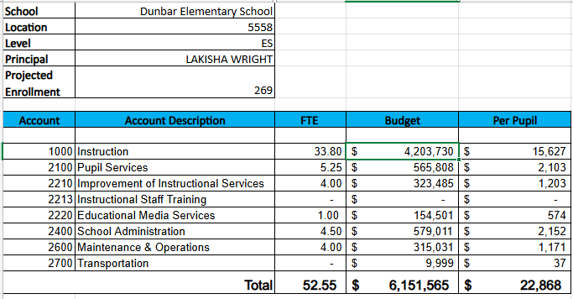
FY26 Budget by Function
* Based on Current Allocation of School Budget

Slide 45
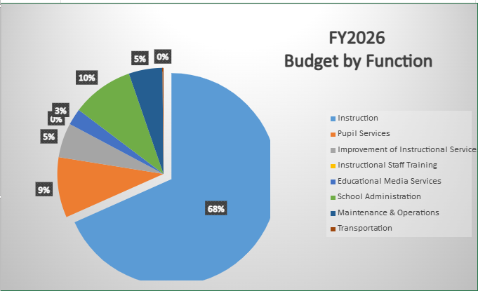
FY26 Budget by Function (required)
* Based on Current Allocation of School Budget

Slide 46
Questions for the GO Team to Consider and Discuss
Strategic Alignment and School-Level Flexibility
Does this budget proposal, as a whole, effectively support our school's strategic priorities?
How do the principal’s proposed changes directly support priorities in our strategic plan? Can we clearly connect each adjustment to a strategic goal?
If new positions, resources, or programs are being added, what data or feedback supports these changes? How will we measure their impact?
What trade-offs are involved? Are any current programs or resources being adjusted or reduced, and how will that affect our students and staff?

Slide 47
Questions for the GO Team to Consider and Discuss
District and Cluster Priorities
How do these proposed changes align with district and cluster priorities? Do we foresee any challenges or misalignments?
If the district has allocated funds for specific initiatives – for example Signature Programs - how are those reflected in our budget?
If we are sharing staff positions (e.g., nurse, counselor, teacher), how will this affect student support and service delivery at our school?

Slide 48
Discussion of Reserve & Holdback Funds

Slide 49
Plan for FY26 Leveling Reserve
$75,840
Priorities | Strategies | Requests | Amount
Create an environment that motivates and retains staff members. | Dunbar is fully staffed with the amount of needed teachers per grade levels to maintain class sizes of less than 20 with the various needs | Maintain the total number of teachers (3 Teachers per grade level in 3-5) | $2,048,000

Slide 50
Plan for FY26 Title I Holdback
$-19,500
Priorities | Strategies | Requests | Amount
Increase level of rigor and relevance (example- please remove) | Implementation of guided reading training for all staff (example- please remove) | Purchase an additional Teacher (example- please remove) | $84, 134 (example- please remove)
EXAMPLE

Slide 51
Action on the
FY26 Draft Budget
The GO Team needs to TAKE ACTION (vote) on its draft FY26 budget.
After the motion and a second, the GO Team may have additional discussion.
Once discussion is concluded, the GO Team will vote.

Slide 52
Where We’re Going
Our next meeting is the Budget Approval Meeting
What:
During this meeting we will review the budget, which should be updated based on feedback from the staffing conference, Associate Superintendents, and key leaders. After review, GO Teams will need to take action (i.e., vote) on the FY26 Budget.
Why:
Principals will present the final budget recommendations for GO Team approval.
When:
All approval meetings must be held after staffing conferences. Budgets must be approved by March 14th.

Slide 53
What’s Next?
February
  Cluster Superintendent Review (February 17-21)
  HR Staffing Conferences (February 24– February 27)
March
  Final GO Team Approval Meeting (AFTER your school’s Staffing Conference and BEFORE Friday, March 14th)
    ACTION (i.e.- GO Team votes) on final budget recommendation before March 14

Slide 54


declare by February 28!
tinyAPS.com/?2025GOTeamDeclaration

Slide 55
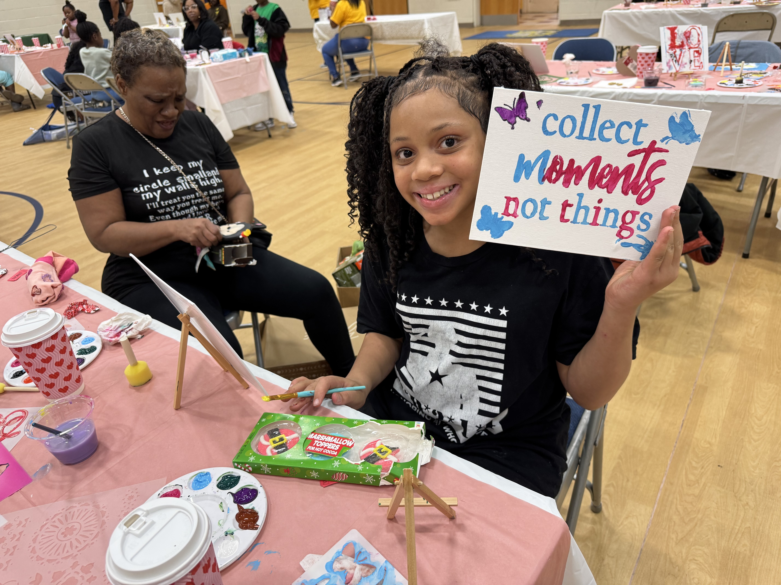
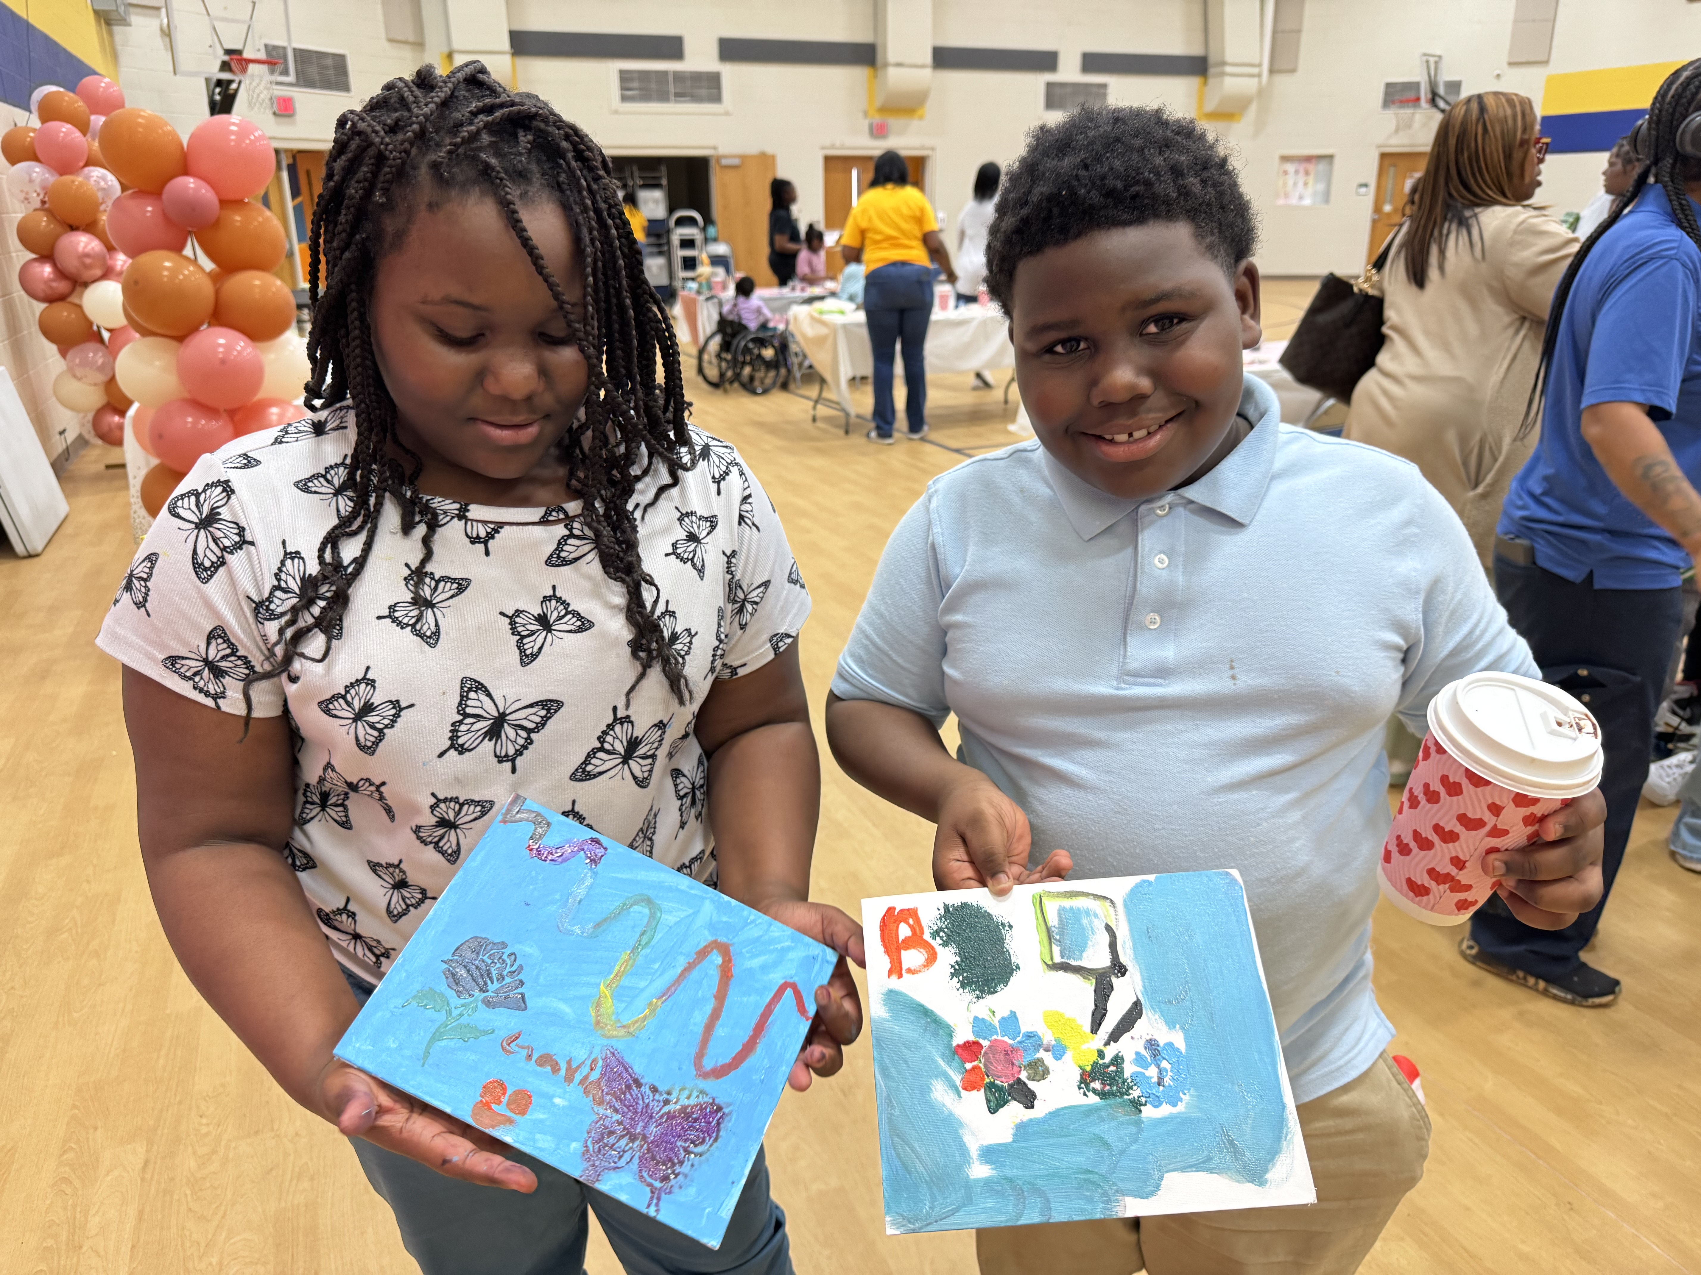
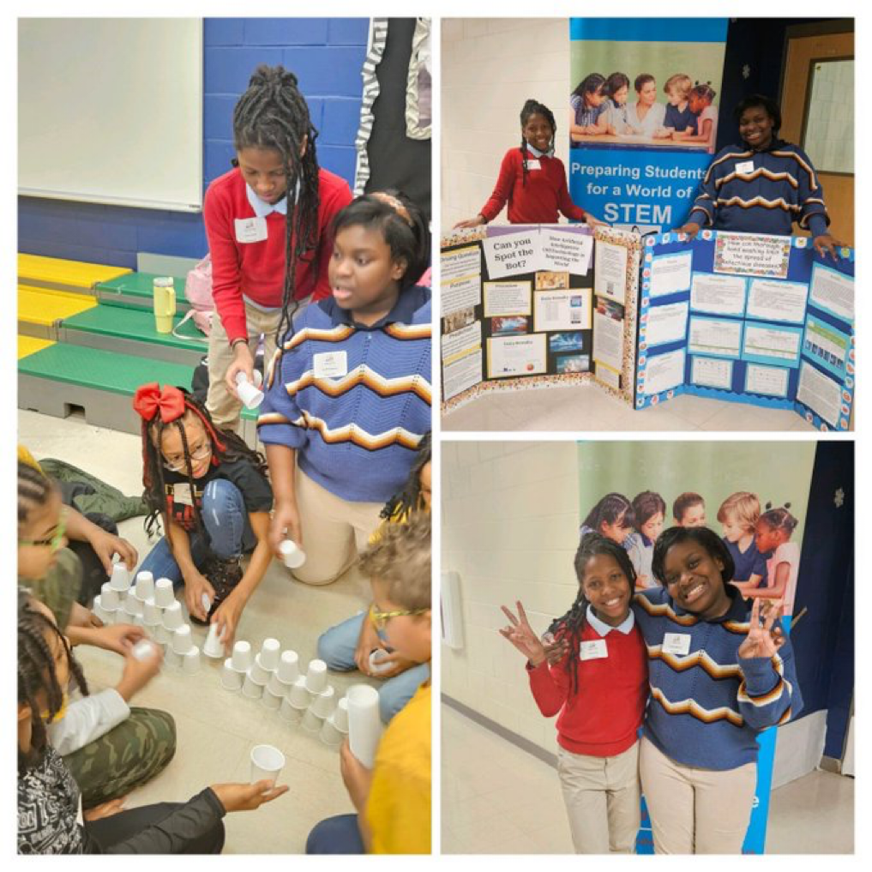
Thank you!
Cocoa and Canvas was a huge Success! The families enjoyed spending quality time with their scholars.
107 in Attendance
AttenDANCE Parties have been EPIC – Special Thanks to Norfolk Southern for their continuous Support.
Week 1: 212 Students
Week 2: 224 Students
Dunbar Elementary School has School and District SCIENCE FAIR WINNERS

Slide 56
Will be updated As soon as possible

